Slide 1
Section 11.2 Series
Lecture 2
Geometric Series

Slide 2
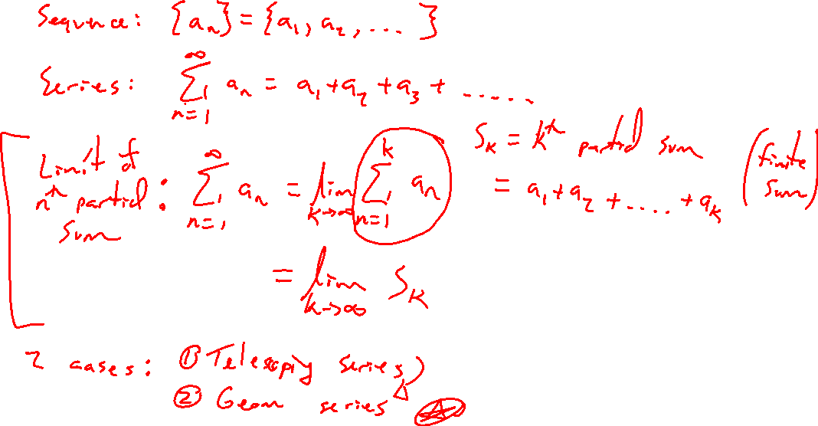
Series Recap
Notes:
Limit of nth partial sum
Telescoping series

Slide 3

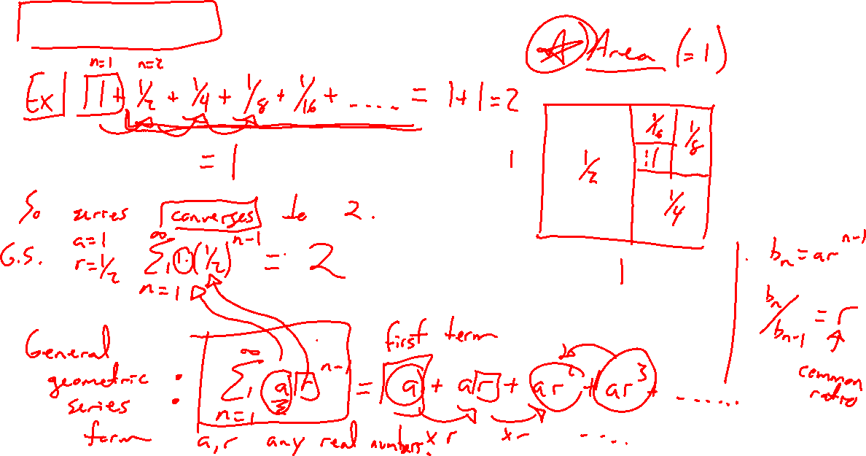
Geometric Series Idea
Notes:
Ex: 1+½+¼+1/8+ …
Draw a 1x2 rectangle with area 2, argue this series converges to 2
General series notation: sum_{n=1}^{\infty} a r^{n-1} = a + ar + ar^2 + … (first term is a, mult by common ratio r each time)

Slide 4

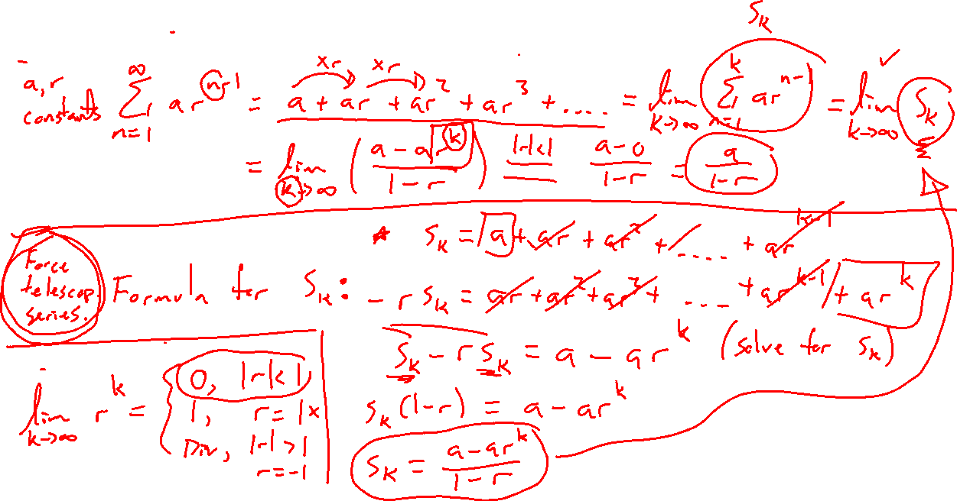
Geometric Series Formula
Notes:
General case: sum_{n=1}^{\infty} ar^n-1
Strategy: Find a formula for the partial sum, use telescoping sum trick S_n – rS_n = a-ar^n
Take limit of partial sum, need |r|<1 for finite
Check formula works for example 1+½+¼+…
See book for general geometric proof

Slide 5
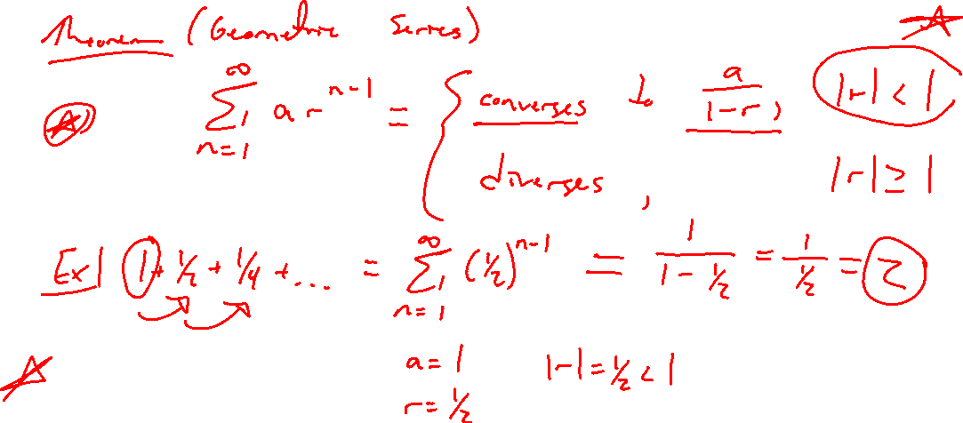
Geometric Series Formula
Notes:
Assume 4-3+9/4-27/16+… is geometric. Show div or conv, find sum if conv
Find a, r and write in general form

Slide 6
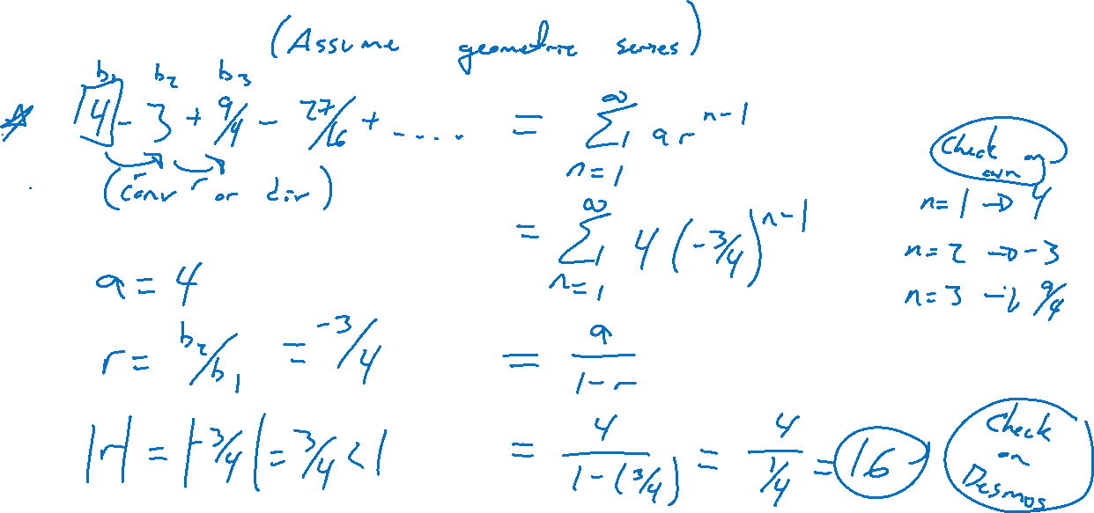
Example
Notes:
Assume 4-3+9/4-27/16+… is geometric. Show div or conv, find sum if conv
Find a, r and write in general form

Slide 7
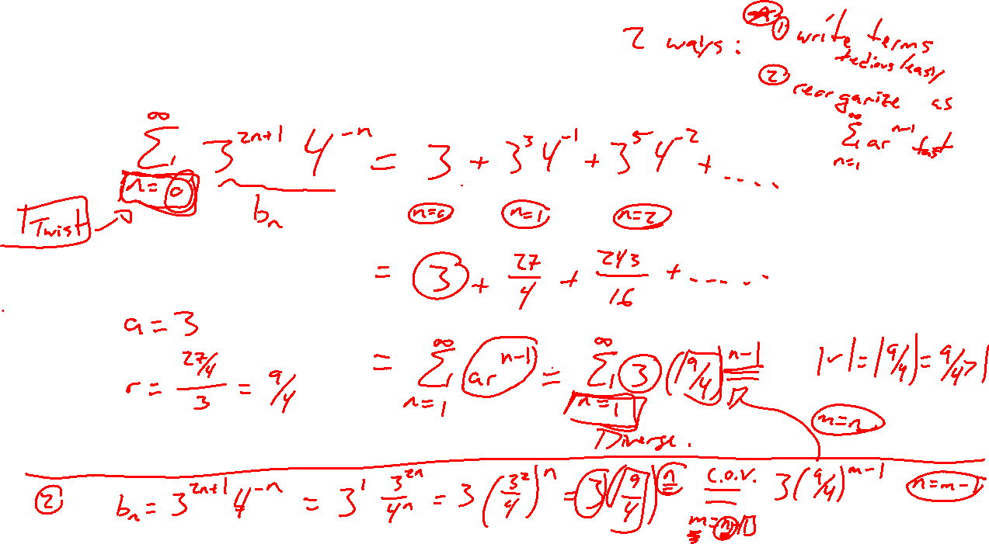
Example: Try on Own
Notes:
\sum_{n=0}^{\infty} 3^{2n+1} 4^{-n} (note index not starting at 1)
Write out series, find first term a, common ratio r.
Diverges

Slide 8
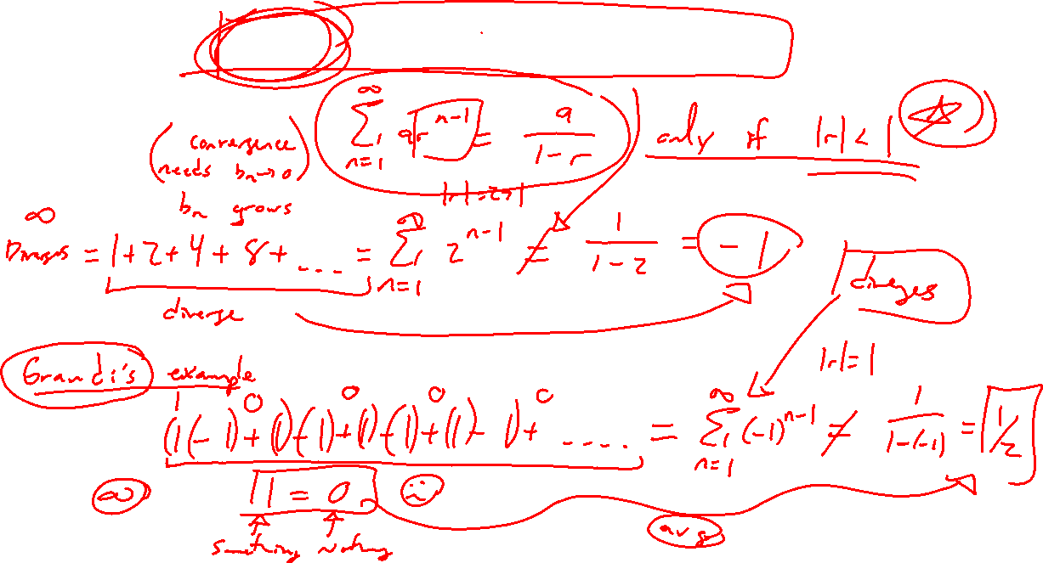
Pitfalls: Check Convergence Criteria
Notes:
1+2+4+8+…=-1
1-1+1-1+1 … = ½
Both diverge in. Need a_n \rightarrow 0

Slide 9
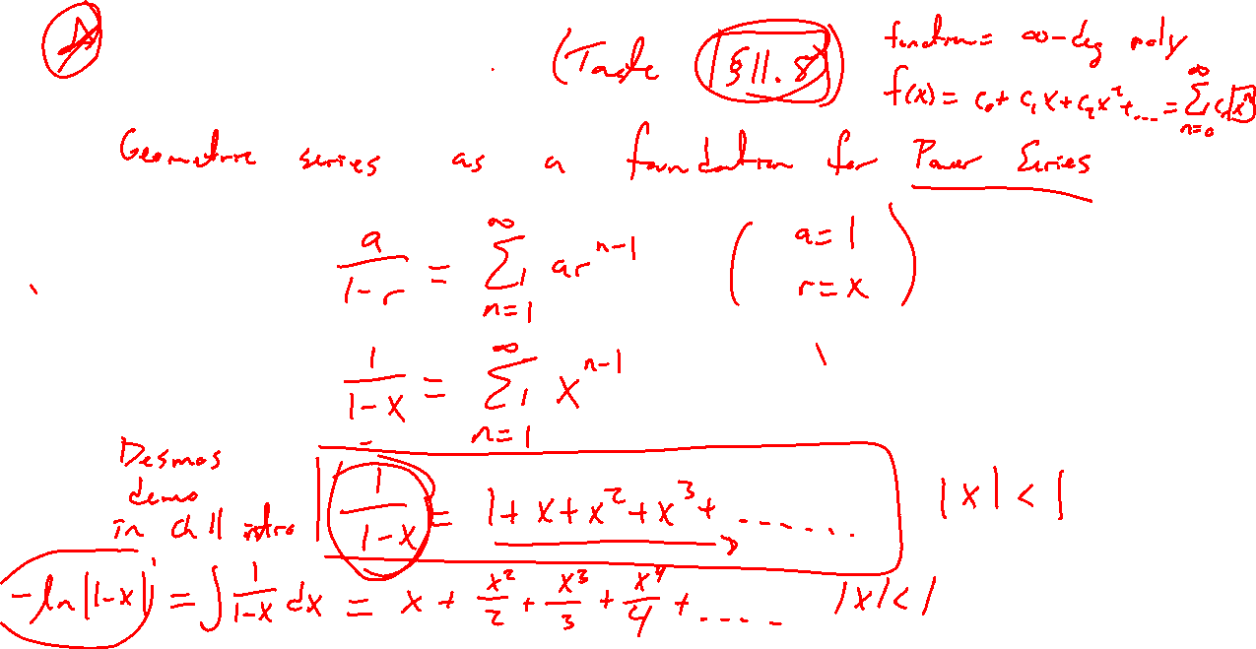
Power Series Idea
Notes:
Take a=1, r=x be a variable.
1/(1-x) = 1+x+x^2+…. , |x|<1
Desmos example from before.
Differentiate / integrate to get new series.
More in section 11.8

